Slide 1
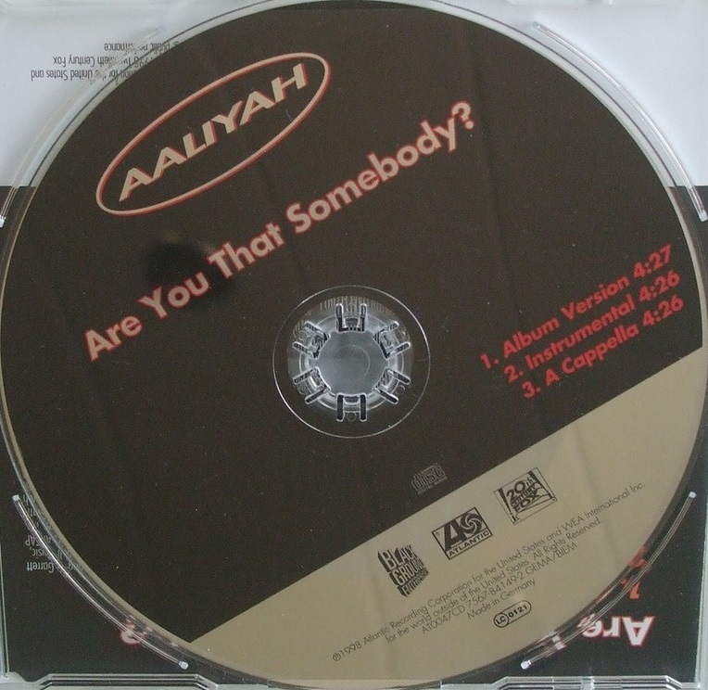
Audio Source Separation Comparison: Main Mix To Instrumental and A Cappella
CD circa 1998
Unsupervised
Supervised
Gaussian Mixture Smoothing
Clustering + Repeating Period
Spectra Clustering
Hidden Markov w/ Training Set
Input
Validation
https://github.com/yaowser/audio-separation
Yao Yao MSDS 7335 402

Slide 2
Motivation
Audio separation techniques have existed prior to and could be enhanced by machine learning
Techniques could be validated with official versions of separated audio
Listening to high accuracy results could be enjoyable
Best techniques could be applied towards audio where official versions of separated instrumentals and a cappellas are unavailable
https://www.discogs.com/Aaliyah-Are-You-That-Somebody/release/346060

Slide 3
Contemporary Music
Dataset: Promotional CD singles
Real life example: .mp3 compressed 128 kB/s
Input: Main version to machine readable
.mp3: 3.7 kB to uncompressed .wav: 23.1 kB
Output: DIY instrumental and a cappella
uncompressed .wav: ~23 kB to .mp3: ~4 kB
Validation: Official instrumental/a cappella
.mp3: 3.4 kB and 3.5 kB, respectively
Separation: Real life application
https://img.cdandlp.com/2013/08/imgL/116134081-2.jpg
https://www.discogs.com/Aaliyah-Are-You-That-Somebody/release/346060

Slide 4
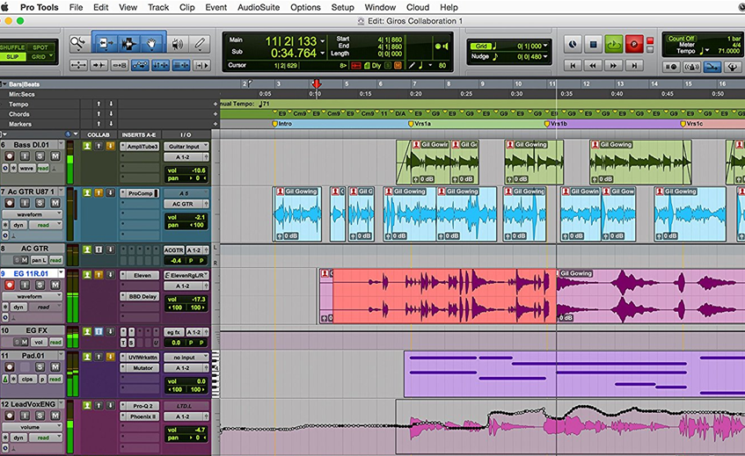
Contemporary music is created by layering and mixing vocals over instrumentals. Want collective harmony. The instrumental for contemporary music is often redundant.
https://images-na.ssl-images-amazon.com/images/I/91Eby8WrdtL._SL1500_.jpg

Slide 5
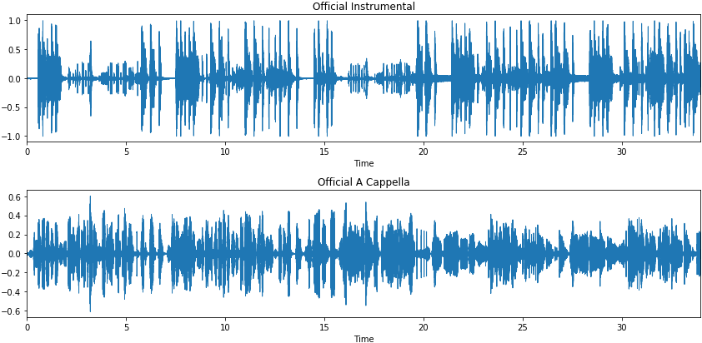
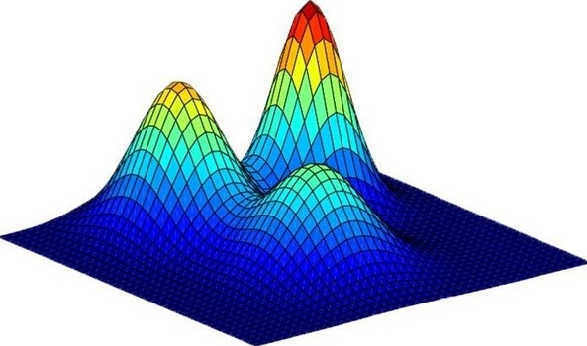
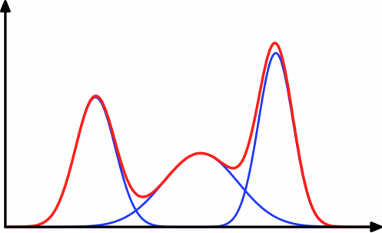
Amplitude
Amplitude
Gaussian Mixture Modeling identifies normal distributions overlaid over each other for unsupervised separation:
<- 2D amplitude vs time and
3D decibels vs hertz vs time ->
Db
Amplitude
Time
Hz
Time
https://dirichletprocess.weebly.com/clustering.html
https://www.quora.com/What-is-an-intuitive-explanation-of-Gaussian-mixture-models

Slide 6
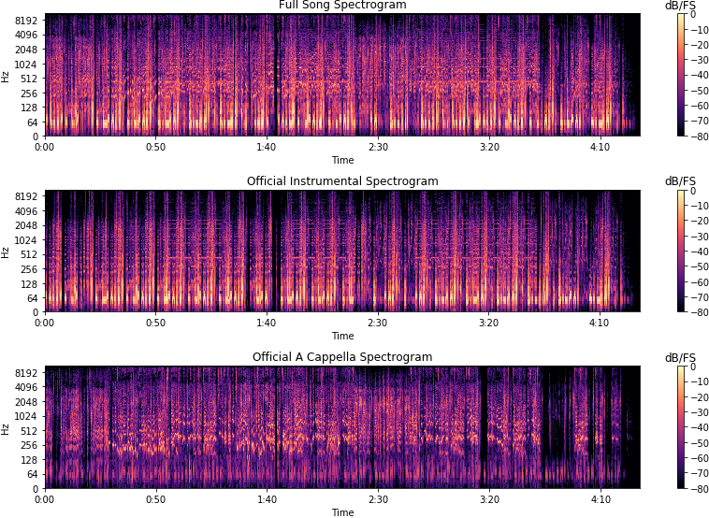
Sound spectra is 3D: time, dB, Hz (log scale). The sound structure has to have texture, sharp outlines, and are full after the separation process

Slide 7
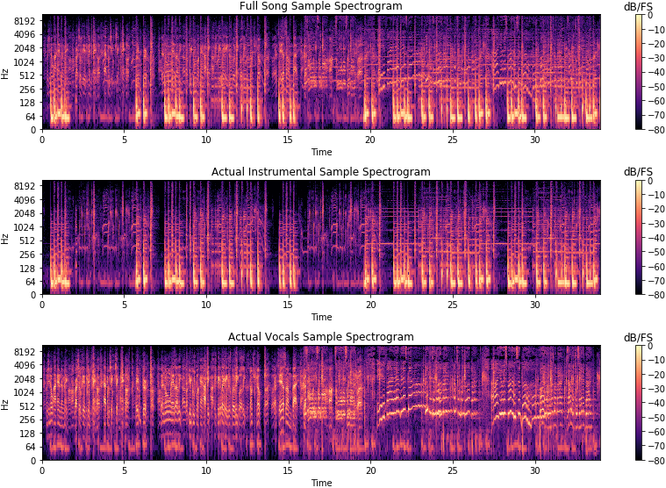
dB and Hz structure can maintain similar magnitude across separated audio: threshold allowance
35-second sample of spectrogram (@1:28). Horizontals are instrumentals, curved are vocals. Not a simple subtraction where vocals are carved out

Slide 8
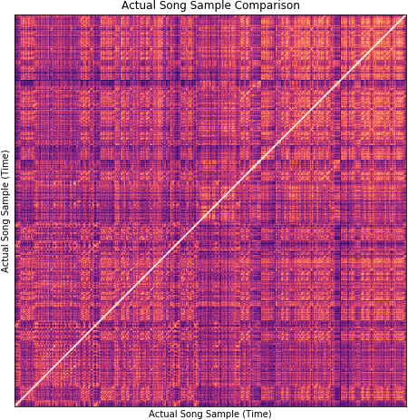
Validation: Normalized Distance Between Spectrograms
Scalar Mel-frequency cepstral coefficients (MFCC) comparison:
Fourier transform
Map frequency into pitch
Discrete cosine transform
Plot path/cost of comparison
Take normalized difference
The cost is how the transformed data compare over time vs. time axes
The path is how much distance the white path deviates from a perfect 45°
After transformations, data integrity is kept but the units become abstract
Normalized distance between full song and itself: 0

Slide 9
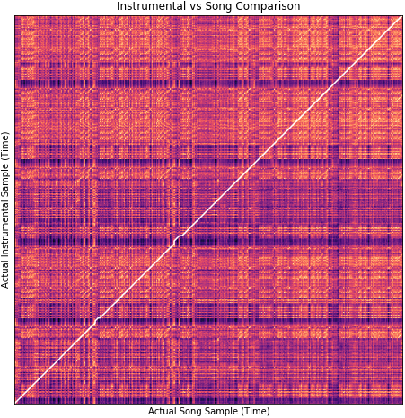
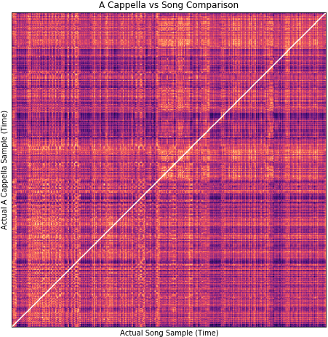
Baseline Test to Evaluate Separation Techniques
Song and Instrumental: 143.34
Song and A Cappella: 146.31
If separation techniques are successful, the distance between DIY versions and the actual versions, respectively, should diminish to 0

Slide 10
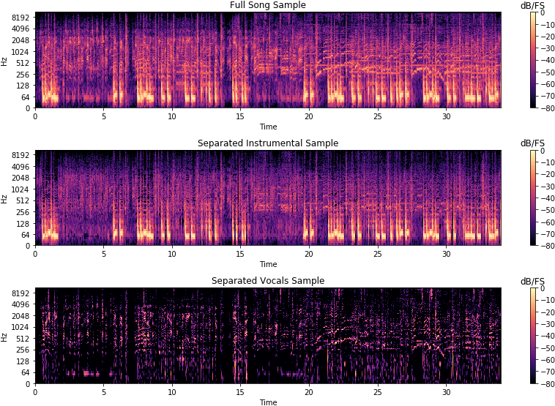
Distance from real instrumental: 135.49 (Baseline: 143.34)
Distance from real a cappella: 283.28 (Baseline 146.31)
Gaussian Mixture Smoothing solves for instrumentals easier; vocals are mostly non-Gaussian.
Bad consequences of subtraction separation: overcompensate for one output can deteriorate the other in quality: grainy, robotic, underwater

Slide 11
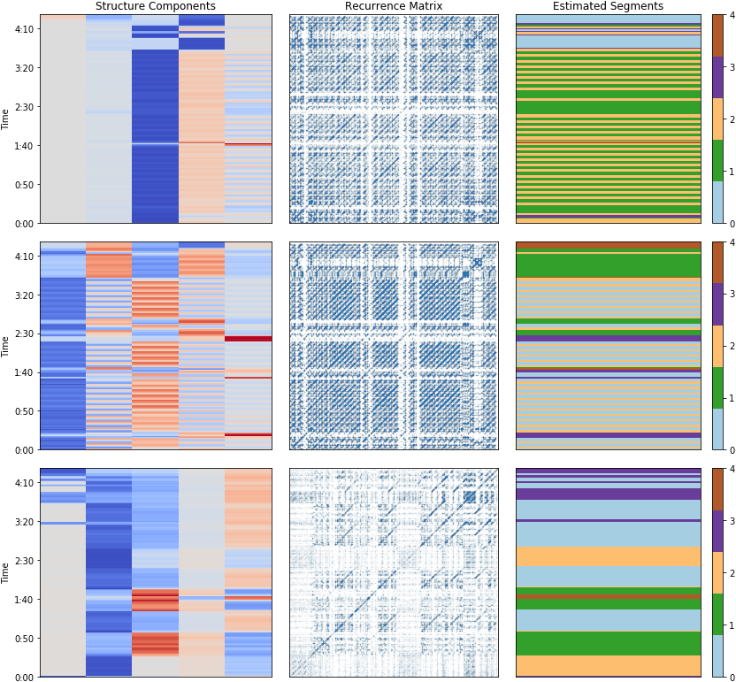
Full Song
k = 5
clusters
Instrumental
k = 5
clusters
A cappella
k = 5
clusters
Repetition could be clustered by k-means. Overlay clusters on their spectrograms

Slide 12
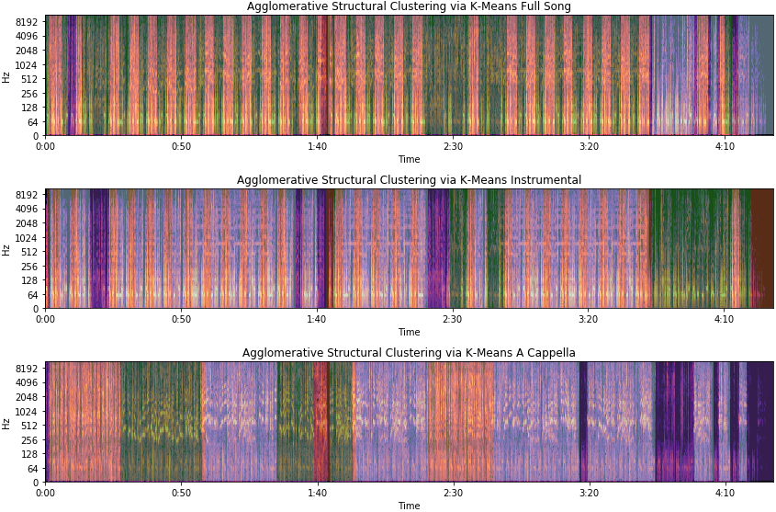
Distance from real instrumental: 101.26 (Baseline: 143.34)
Distance from real a cappella: 155.26 (Baseline 146.31)
Unsupervised Clustering
Repeating instrumental segments are correlated with full song. Increase clusters to find optimal repetition. Use full song only for separation

Slide 13
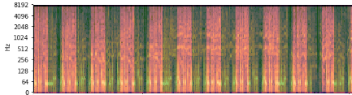
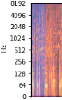
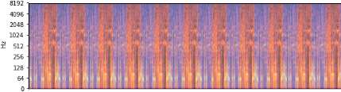
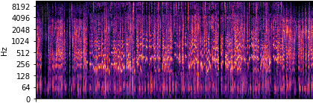
Residual Separation from Median Repeating Period
Full Song Spectrogram
Median Spectrogram
1p
2p
3p
4p
5p
6p
7p
8p
9p
10p
11p
1p
Period optimization:
instrumental pattern repeats every 6.9334 seconds
p
p
p
p
p
p
p
p
p
p
p
p
Use original spectrogram to create a median repeating segment per time period (p)
DIY Instrumental Spectrogram
DIY A Cappella Spectrogram
1p
2p
3p
4p
5p
6p
7p
8p
9p
10p
11p
p
p
p
p
p
p
p
p
p
p
p
DIY instrumental: How far from median repeating spectrogram is allowed to repeat along original
DIY a cappella: Outliers of a threshold from the median repeating DIY instrumental
Thresholds are needed because not pure subtraction separation
(Take what you need method) http://zafarrafii.com/#REPET

Slide 14
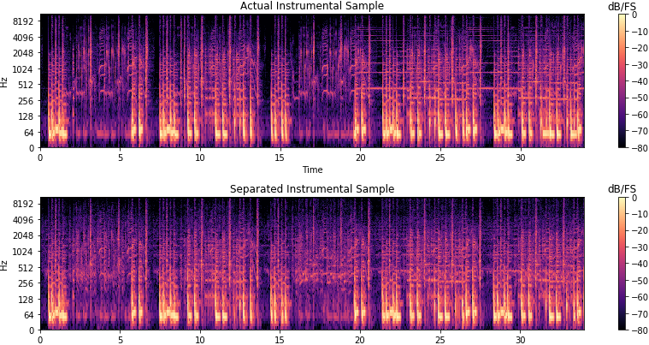
Clustering + Repeating Period: Optimal Normalized Distance
Time spent to optimize parameters by ear
DIY Instrumental vs. actual: 98.08 (Baseline: 143.34)
Instrumental margin = 1, A cappella margin = 0.5
Note the fullness of the spectrum because the median

Slide 15
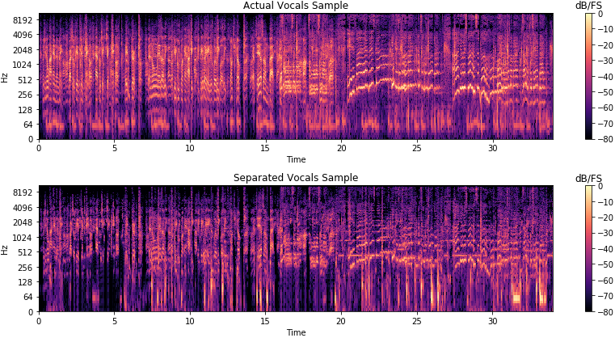
Clustering + Repeating Period: Optimal Normalized Distance
Time spent to optimize parameters by ear
DIY a cappella vs. actual: 101.20 (Baseline 146.31)
Instrumental margin = 1, A cappella margin = 0.6
Note the gaps in the spectrum despite the median threshold

Slide 16
Multimedia Information Retrieval Dataset
A cappella, instrumental, or both
1000 labeled .wav files (516 MB total)
Stereo 16KHz sample rate
4 to 13 seconds
Male and female vocals
Create a Hidden Markov model with spectral patterns
70% Training, 20% Testing, 10% Validation
https://sites.google.com/site/unvoicedsoundseparation/mir-1k
http://www.cs.northwestern.edu/~jha222/imputation

Slide 17
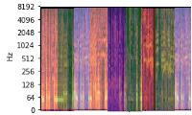
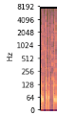
Trained Hidden Markov Model
Labeled spectrogram dictionary of vocals and music:
Permutation: overlaying sounds together
Permutation: sequencing sounds together
Calculate the probability of transitions for both
Hidden Markov Model is used to find the
transition probabilities of certain sequencing and certain overlays of labeled
sound
(Long iterative process)
Data augmentation from dictionary: sound sequencing and overlaying chains
http://slideplayer.com/slide/4757315/

Slide 18
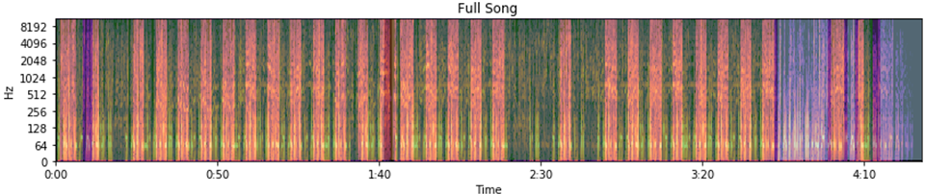
Stepwise Probabilistic Matching
Use probability of labeled sound sequencing and overlays to match pattern alignment with song spectra
Validation by highest probability hidden Markov model
Isolate instrumental and a cappella from full song by subtraction with the matched sound overlay
Results dependent on quality and diversity of dataset

Slide 19
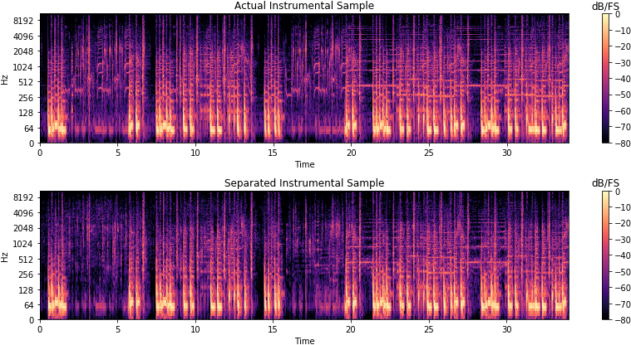
Trained Hidden Markov Model: Normalized Distance
Time intensive approach to label, train, iterate
DIY Instrumental vs. actual: 100.6 (Baseline: 143.34)
vs. Clustering + Repeating Period: 98.08
Gaps in separation with misinterpreted matched probabilities

Slide 20
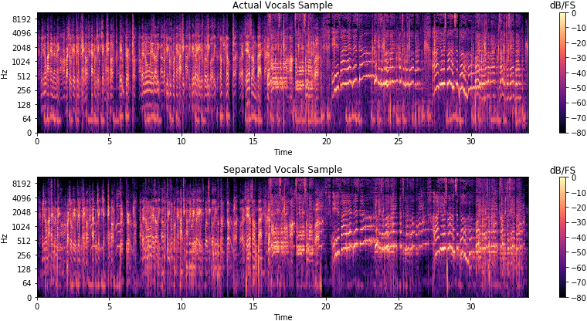
Trained Hidden Markov Model: Normalized Distance
Time intensive approach to label, train, iterate
DIY a cappella vs. actual: 111.6 (Baseline 146.31)
vs. Clustering + Repeating Period: 101.20
Gaps in separation with misinterpreted matched probabilities

Slide 21
Conclusion / Best Method:
Clustering Repeating Period + Optimization:
Pros:
Fast, data self contained by song file
Cons:
Limited by sample
Manual optimization by ear
Supervised Hidden Markov Model (Overlay + Sequencing):
Pros:
Very precise depending on dataset
Cons:
Weird separation from probabilistic matching
Time intensive labeling, training, iteration
Winner by time, results, generality
https://github.com/yaowser/audio-separation

